Slide 1
Lasers in dentistry
Kristian Iliev and Lyuben Aleksiev

Slide 2
Introduction
The in and outs of lasers
Tissue interactions
Variety of laser technology
Dental and surgical uses of lasers
Resources
Notes:
In this presentation you are going to hear more about about how a laser works, about different interactions between the lasers and various tissue and the uses of different laser technologies in dental medicine and oral and maxillofacial surgery.
And now lets get started

Slide 3
Ins and outs of lasers
L.A.S.E.R.
Functioning of a laser
Introduction of lasers to Dentistry
Pros and cons
Notes:
First of all, the word LASER is an acronym for light amplification by stimulated emission of radiation. A laser emits a beam of coherent light through an optical amplification process.
Lasers were introduced into the field of dentistry as they are a precise and effective way to perform many dental procedures. Treatment with lasers provides a hope of overcoming the disadvantages of “traditional” dental procedures like inpercision of the hand, pain and recovery time. The laser technology has impact over every discipline of the dental medicine including oral medicine, oral surgery, pediatric and operative dentistry, periodontics and implantology, prosthetic dentistry. Unfortunately, there are a few disadvantages of lasers in this field. The main are the disability to treat teeth with fillings, interdental cavities and remove damaged prosthetic restorations. The price could be a problem as well.

Slide 4
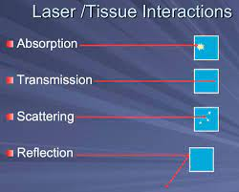
Tissue interactions
4 types of interactions
absorbtion
Transmition
Scattering of the laser light
Reflection
Notes:
There are 4 main types of laser interactions with tissues; The first one is absorption, which is characterised with the absorption of the beam by the tissues. The absorption depends on the wavelength of the laser and the type of the tissue. This enables the usage of lasers on different tissues without impacting other neighbouring tissues. Transmission - depends on the wavelength of the laser beam and is characterising the effect on adjacent tissues, Reflection - is exactly what it sounds like and is basically the laser not reaching the targted tissue and having an impact on other unintended tissues that beam was reflected to. Scattering - is occurring when the laser gets scattered thus the surrounding tissue absorps heat which can lead to unwanted damage on the adjacent tissues.

Slide 5
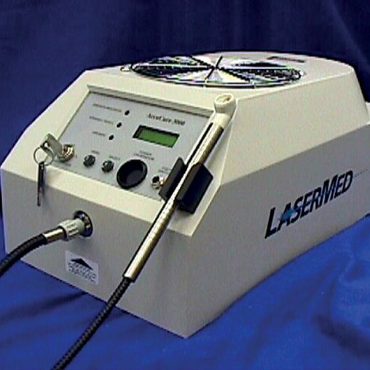
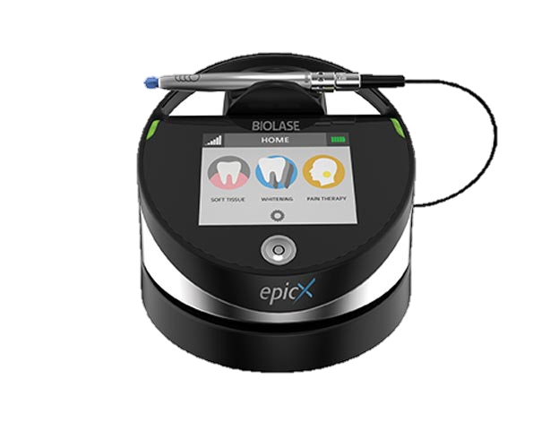
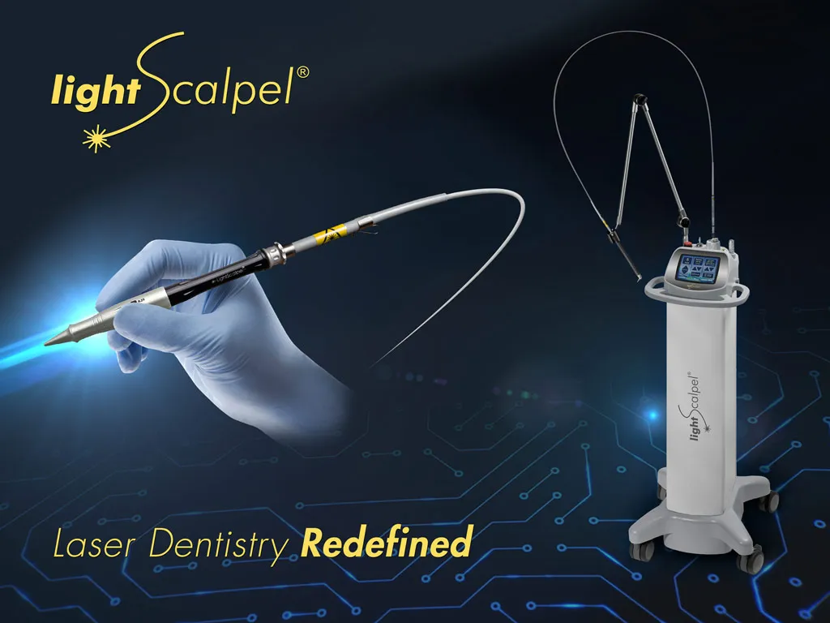
The variety of laser technology
Argon Lasers
Diode Lasers
CO2 Laser
Nd-YAG Lasers
THE ERBIUM FAMILY
Notes:
Lyubo: Lasers are classified into 3 major categories. There are gas, liquid, solid semiconductor and excimer lasers. Here we will present the most commonly used ones.
Diode Lasers which are solid have a wavelength of 800 to 900 nm. (The diode laser is manufactured from solid semiconductor crystals made from a combination of aluminium (with a wavelength of 800 nm) or indium (900 nm), gallium and arsenic) These lasers are excellent for soft tissue surgery, as these wavelengths are poorly absorbed by the hard tissues in the mouth. This laser is indicated for gingivoplasty, sulcular debridement and deeper coagulation process on gingival and mucosa. Its biggest advantage is its small size and portability.
Argon lasers that belong to the gas ones have two emission argon laser wavelengths used in dentistry: 488 nm (blue) and 514 nm (blue-green). Both wavelengths are poorly absorbed by the hard tissues so just like the diode laser, they are used for sculpting gingival tissues without causing damage to the tooth surface. Another application of the argon laser is an aid for carries detection.
Kris
CO2 laser; is based on discharging a gaseous mixture with CO2, and the whole system is cooled by gas or water. This laser is with a wavelength of about 10 600 nm which falls into the infrared spectrum. This means that this laser can be easily absorbed by water and doesn't have a great penetrating ability. This laser is most often used for coagulation and cutting soft tissues. The post-operative pain is little to none, But on the downside, there can be delayed wound healing due to the delayed re-epithelization. The laser with its properties is used in the treatment of mucosal lesions. [Pic of mucosal lesion]
Nd-YAG laser: Is a laser working with a solid active medium which is garnet, as well as aluminium and yttrium, this is what the name of the laser stands for YAG (Yttrium, aluminium and garnet), these 3 materials are doped by neodymium ions. The length of this laser is around 1060 nm and is used to treat soft tissues. The laser provides great homeostasis thus the operating field is cleaner and easier to work with so procedures such as coagulation and cutting of soft tissues became standard. The length of the laser beam when defocused can reach a couple of mm deep and so it can be used in cases such as aphthous ulcers or pulpal analgesia. On the downside when there is a decrease in the pulpal function the laser can cause damage to the pulp. The laser is used in treatment such as removal of incipient caries although other lasers Er: YAG, lasers do a better job of this.
Erbium, Cr: YSGG; they have an active medium of a solid crystal of yttrium scandium and gallet the length of these lasers is 2780 nm
Erbium: YAG; has an active medium of a solid crystal of yttrium aluminium garnet doped with erbium. These two lasers can be used in caries aid to prepare the cavity. The penetration of this laser is minimal so the effect on the pulp is minimal as well. these lasers don't need to be used with an anaesthetic since the laser is its own and also it has an anti-microbial effect as well as they are less likely to induce pain in the patient.
Er-Cr:YSGG Laser: is widely used in restoration and etching with the ability to provide a rough surface for bonding with no harm to the tissue. Its advantage is that it is safe to use on carious lesions near the gingiva. Also, tissue retraction for implants is safe due to the minimal heat transfer. The downside is that the procedure still requires acid etching to obtain equivalent bond strength.

Slide 6
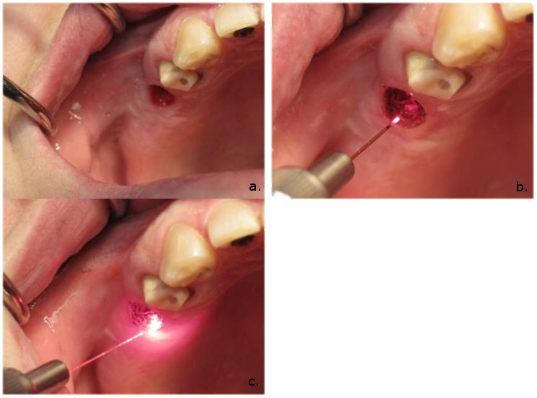
Dental and surgical uses of lasers
Uses of lasers on hard dental tissues
Caries Detection
Caries Removal and Cavity Preparation
Calculus Removal
Assisted Bleaching
Surgical Procedures
Uses of lasers on soft dental tissues
Laser Curettage.
Laser Assisted Incisional and Excisional Biopsy
Photodynamic Therapy
Lasers in Pediatric Dentistry
Notes:
Любо: hard tissues
Caries Detection
The method is called laser-induced fluorescence. When the diode laser irradiates the tooth, the light is absorbed by organic and inorganic substances present in the dental tissues, including bacteria. These bacteria show fluorescence after excitation by red light. Therefore, carious tissue exhibits more fluorescence as compared to the healthy tissue
Caries Removal and Cavity Preparation
The Er: YAG lasers are proven to be safe and effective in caries removal and cavity preparation in pediatric and adult patients without significant damage to tooth structure or patient discomfort. This device also aids in the removal of defective composite restoration and ablate the distal carious lesion
Calculus Removal
The Er: YAG lasers are effective in removing lipopolysaccharides and other root surface endotoxins and are highly bactericidal
Assisted Bleaching
Using the 488-nm argon laser as an energy source to excite the hydrogen peroxide molecule offers more advantages than other heating instruments while avoiding any adverse effects.. Lasers can enhance bleaching by photo-oxidation of coloured molecules in the teeth or by interaction with the components of the bleaching gel through photochemical reactions
Surgical Procedures
CO2 lasers make relatively deep and precise incisions and thus excellent hemostasis. There is less traumatic bone cutting with the use of Erbium lasers resulting in postoperative discomfort for the patients. The CO2 laser provides a bloodless field, less post-operative discomfort, tissue coagulation and better accessibility in some areas of the oral cavity compared to conventional scalpel surgery.
Kris:
Laser curettage: is a non invasive procedure performed wuth the help of Nd:YAG and diode lasers. They can help improve the outcoome of mild and moderate paradontitis. The lasers are so effective because of the antibacterial effect of these lasers but the advantages end there.
Laser assisted incisional and excisional biopsy: the procedures are done at 100°C with the lasers in cutting or focused mode, following the surgical outline. The procedure works by the laser vapourising intracellular and extracellular water as well as minor parts soft tissue, but of the temperature rises above 200°C this can result in permanent necrosis of the tissue.
As well as the requirements that need to be fulfilled for a laser to be used on a certain type of soft tissues and their issues the soft tissues can specifically indicate on whether they can be treated with lasers. Such indications include, gingival depigmentation gingivestomy and more. The lasers can be easily used to remove benign growths such as fibromas
Photodynamic therapy (PDT): is basically a poweful laser-initiated photochemical reaction. The purpose of this reaction is treating and removing malignancies of the oral mucosa in particular, multifocal squamous cell carcinoma. These interventions can be damaging to the surrounding tissue resulting in apoptosiss and necrosis.
As this method destroys almost all the tumour cells, it is proven that this therapy can lead to activating immune response by activating the anti tumor immunity by activating macrophages and T lymphocytes. This treatment is well tolerated due to the quite short healing time for ulcerated lesions that take up to 8 weeks without any diffiulties.
Lasers in Pediatric Dentistry: The use of lasers in pediatrics helps with the fast, precise and selective interventions. The absence of needles and high speed machines is mmore comforting for the children, plus there is no need for stiches.

Slide 7
Resources
David CM, Gupta P. Lasers in Dentistry: A Review. Int J Adv Health Sci 2015;2(8):7-13.
Verma SK, Maheshwari S, Singh RK, Chaudhari PK. Laser in dentistry: An innovative tool in modern dental practice. Natl J Maxillofac Surg 2012;3:124-32.
https://www.researchgate.net/profile/Adam-Husein/publication/45459000_Applications_of_lasers_in_dentistry_a_review/links/0c96052fc9bc6e188a000000/Applications-of-lasers-in-dentistry-a-review.pdf

Slide 8
The End

